Slide 1
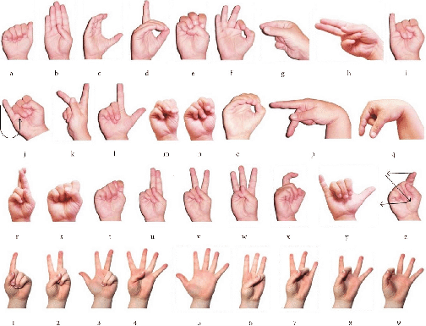
An AI-powered sign language translation device that converts sign language gestures into spoken or written words.
Siddharth Dutta

Slide 3
Training a Machine Learning Model to Recognize Sign Language Gestures
A step-by-step guide to training a machine learning model to recognize sign language gestures, converting the model to TensorFlow Lite format, connecting a webcam to a laptop, capturing the gestures using image processing software, and processing the webcam output.

Slide 4
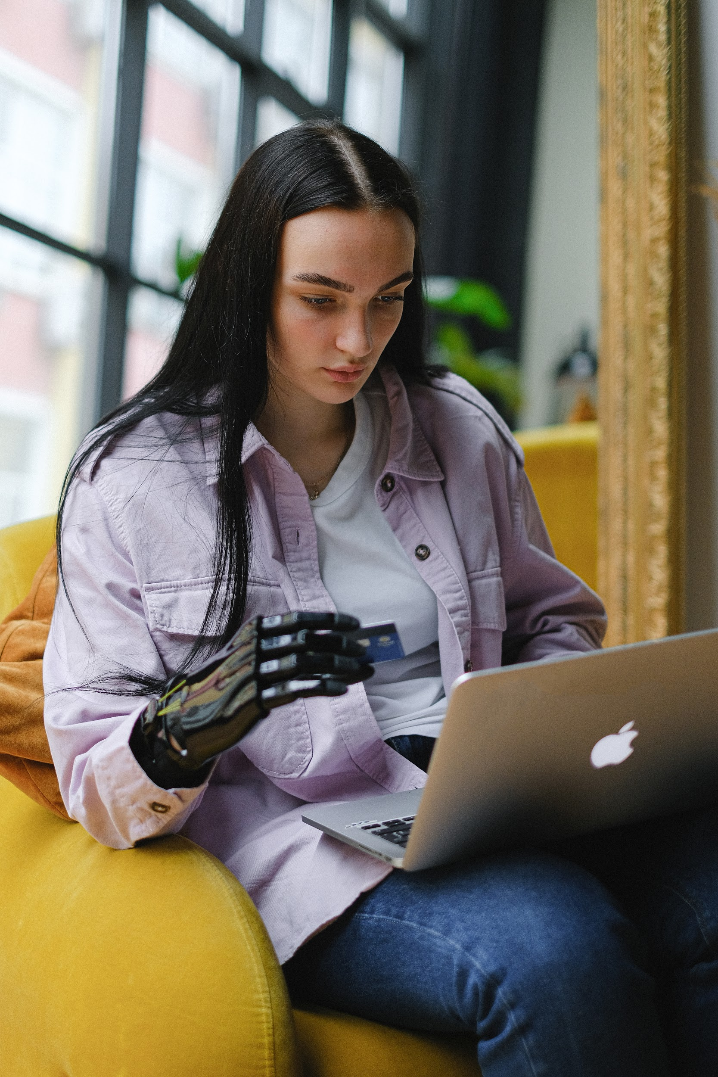
Training a Machine Learning Model
- Using a machine learning library, such as TensorFlow or PyTorch, to train a convolutional neural network (CNN) model to recognize sign language gestures based on preprocessed data.
Photo by Pexels

Slide 5

Converting the Model to TensorFlow Lite
- Convert the trained machine learning model to TensorFlow Lite format, optimized for use on resource-constrained devices, such as the Arduino Uno R3.
Photo by Pexels

Slide 6
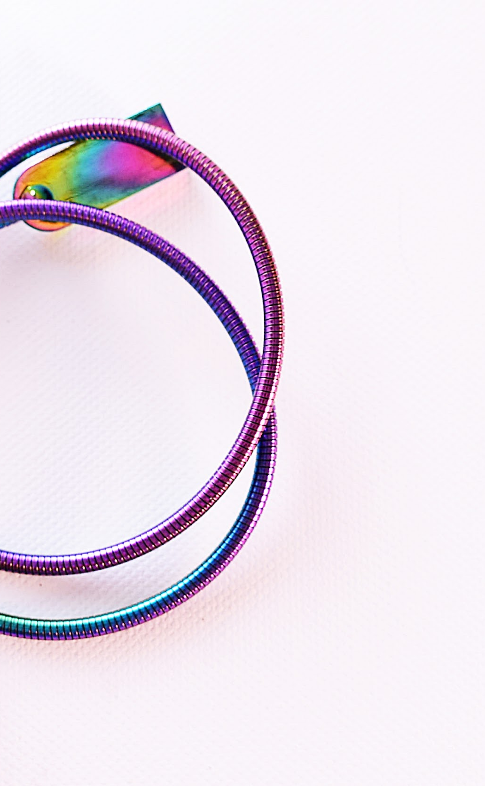
Connecting the Webcam to the Laptop
- Connect the webcam to the laptop using a USB cable.
Photo by Pexels

Slide 7

Processing the Webcam Output
- Use the converted TensorFlow Lite model to process the webcam output and recognize sign language gestures.
Photo by Pexels

Slide 8
Translating Sign Language with Arduino Uno R3
A tutorial for translating sign language gestures into speech or text using Arduino Uno R3 and TensorFlow Lite.

Slide 9

Translate Sign Language Gestures
- Recognize sign language gestures
- Translate them into speech or text using text-to-speech or language translation APIs
Photo by Pexels

Slide 10
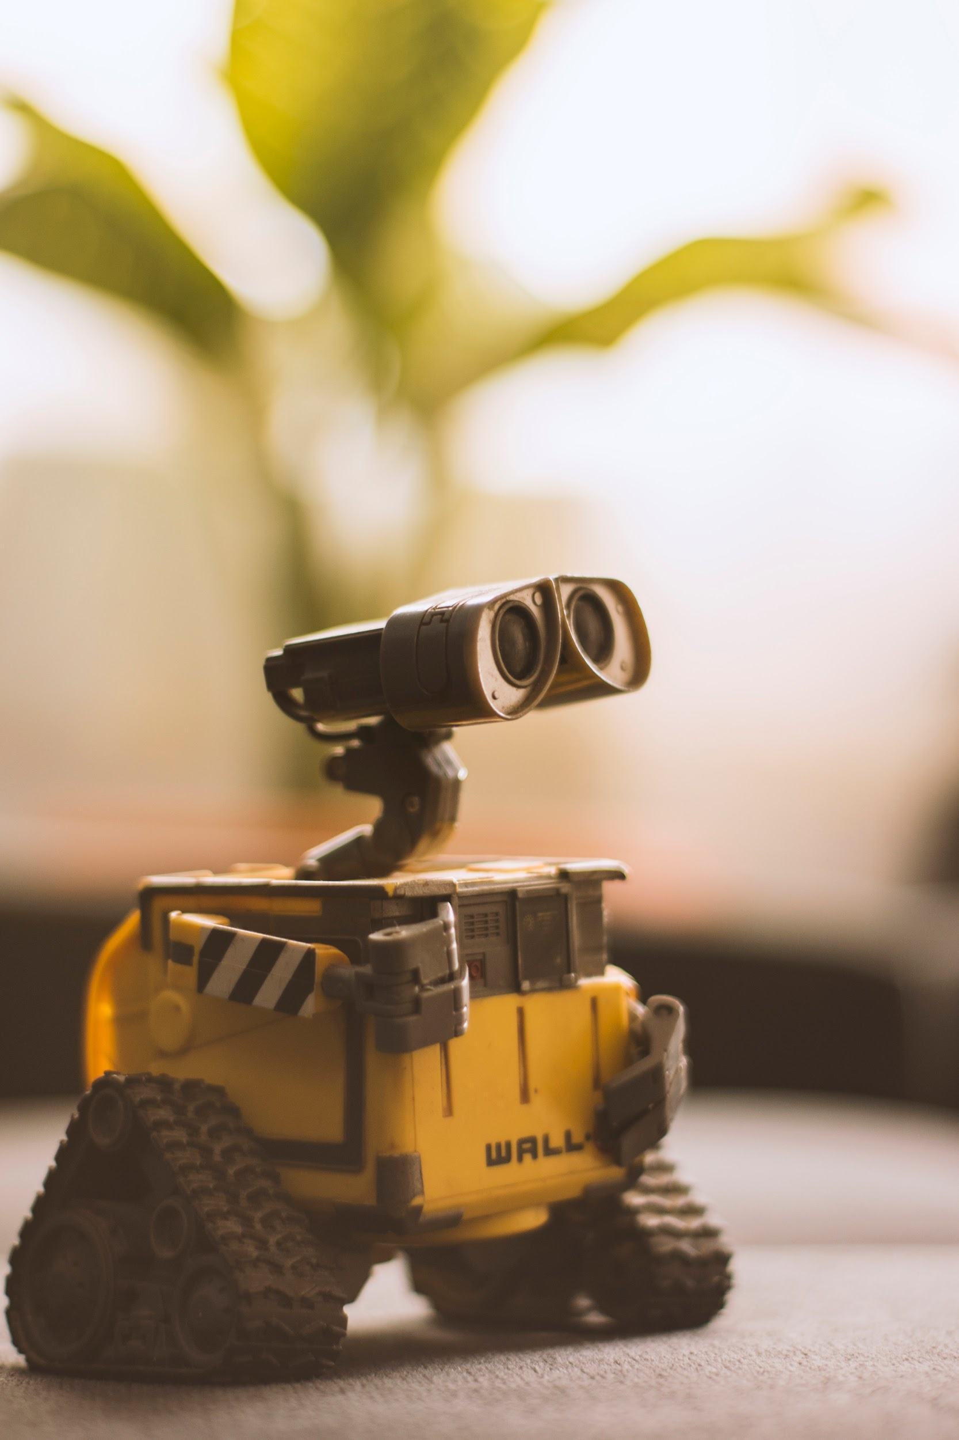
Transfer the Model to the Arduino Uno R3
- Use the Arduino IDE to upload the TensorFlow Lite model to the Arduino Uno R3
Photo by Pexels

Slide 11

Connect the Webcam to the Arduino Uno R3
- Connect the webcam to the Arduino Uno R3 using a USB cable
Photo by Pexels

Slide 12

Output the Translation
- Use the TensorFlow Lite model on the Arduino Uno R3 to process the webcam output and recognize sign language gestures
- Output the translation using the speaker or display connected to the Arduino Uno R3
Photo by Pexels

